Slide 1
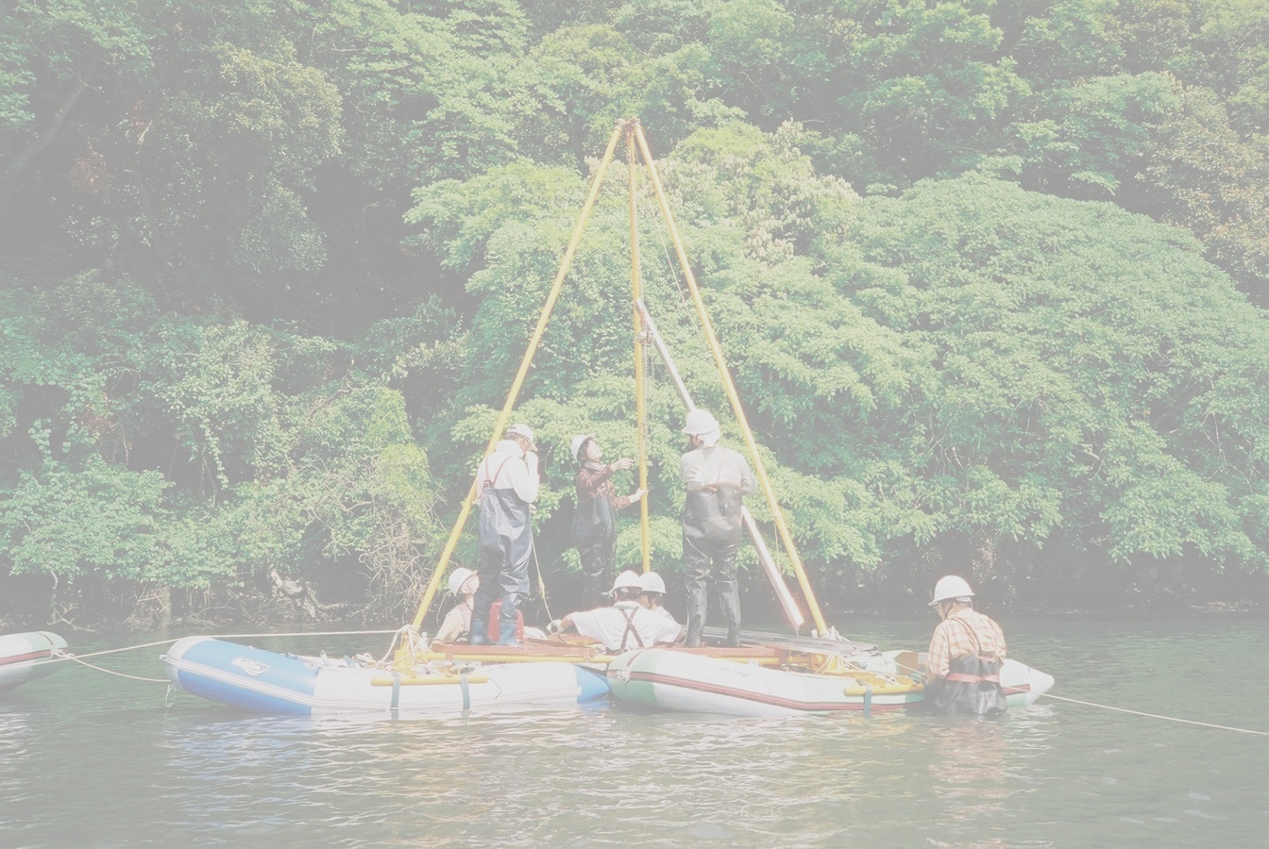
Recurrence of Kanto earthquakes revealed from tsunami deposits in Miura peninsula, Japan
Shimazaki, K.¹, Kim, H. ¹, Ishibe, T. ¹, Tsuji, Y. ¹, Satake, K. ¹, Imai, K. ¹, Tomari, J. ¹, Chiba, T.², Sugai, T.², Okamura, M.³, Matsuoka, H.³, Fujiwara, O.⁴, and Namegaya, Y.⁴
¹Earthquake Research Institute, University of Tokyo, Japan
²Graduate School of Frontier Science, University of Tokyo, Japan
³Graduate School of Science, Kochi University, Japan
⁴Active Fault Research Center, AIST, Japan

Slide 2
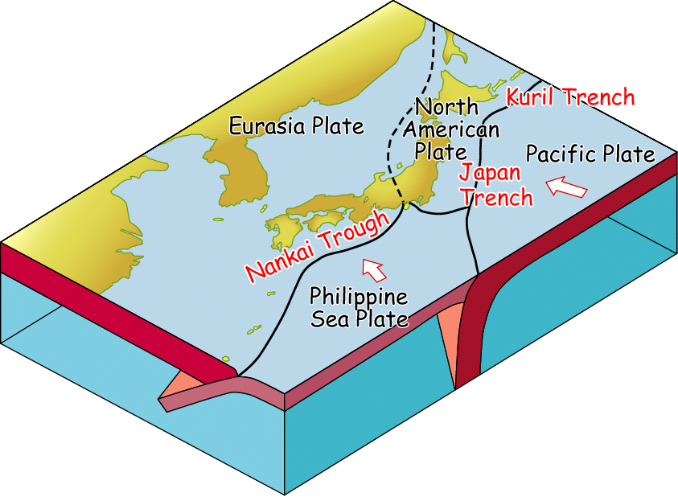
Plates around Japan
Kanto Eq.

Slide 3
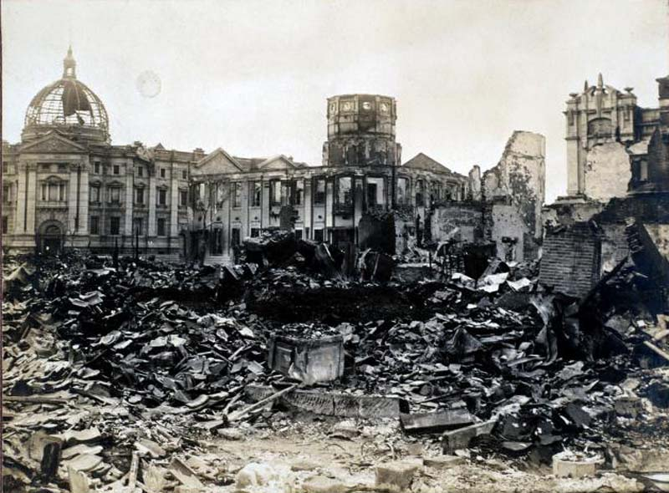
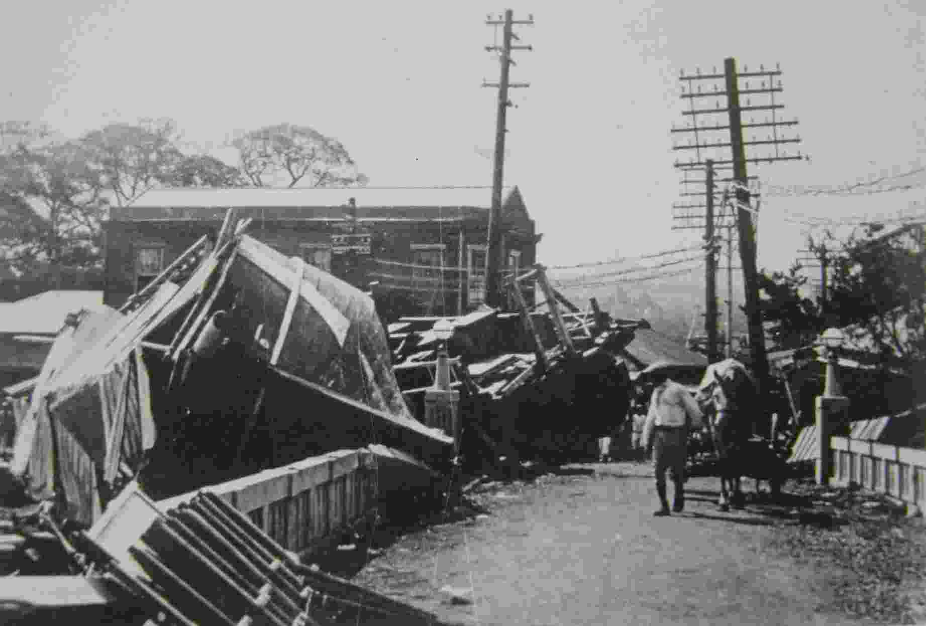
The 1923 Kanto earthquake
Damage in Yokohama City
© Yokohama City Library
Tsunami Damage in Ito City
© Ito City Office
Total casualty ~ 100,000 (The worst earthquake disaster in Japan)

Slide 4
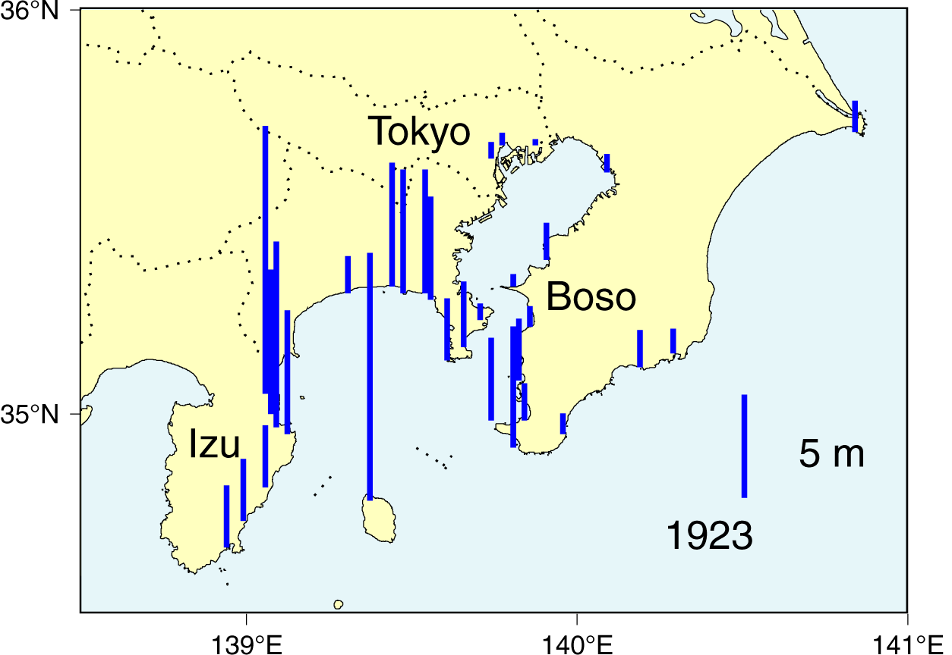
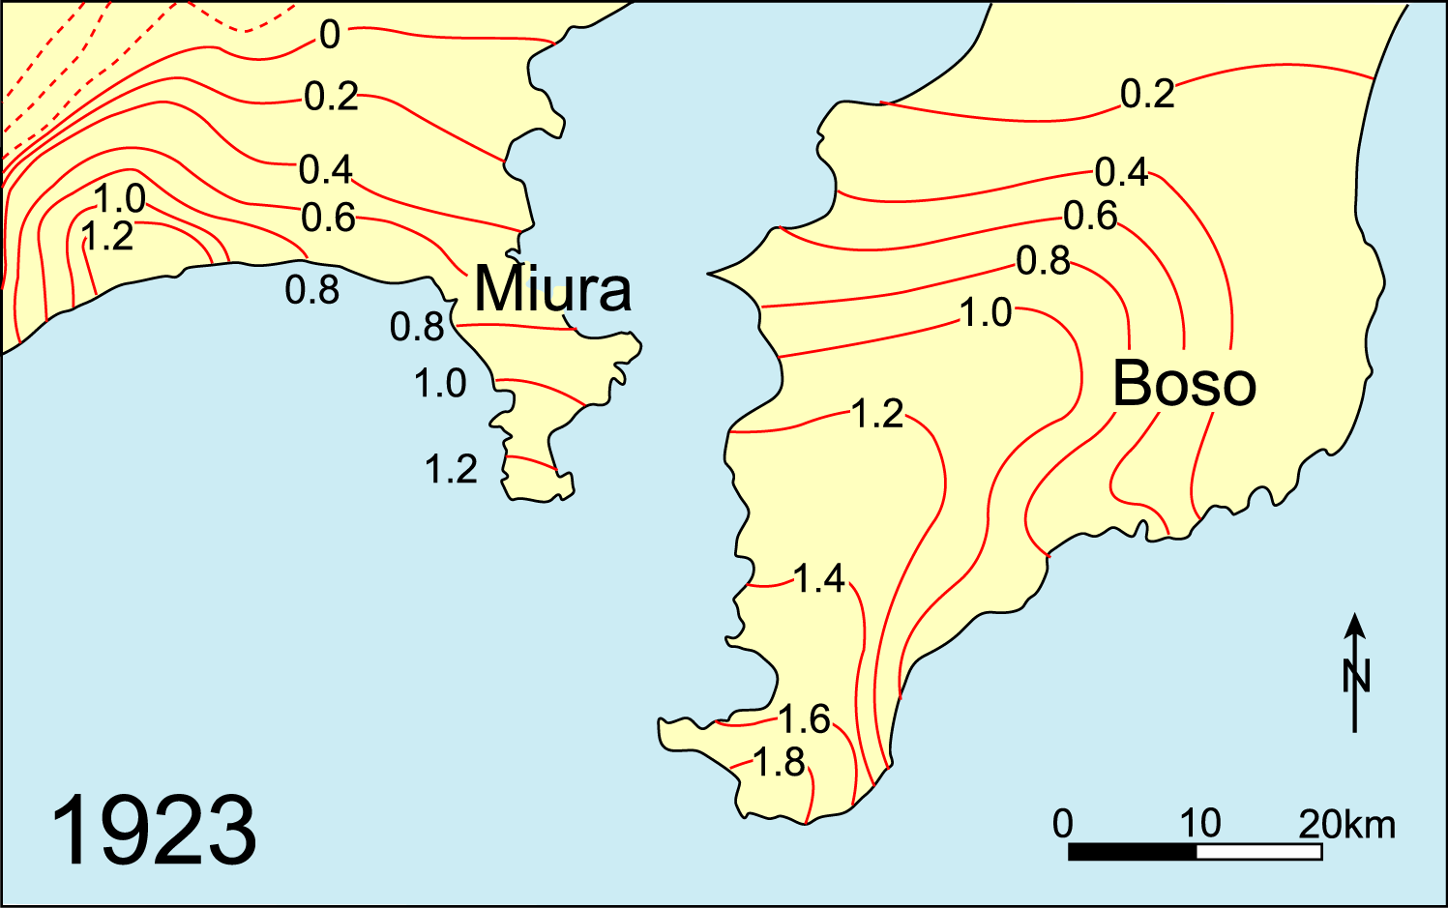
The 1923 (Taisho) Kanto earthquake
Tsunami Heights
Crustal deformation
Hatori (1975)
Miyabe (1931)

Slide 5
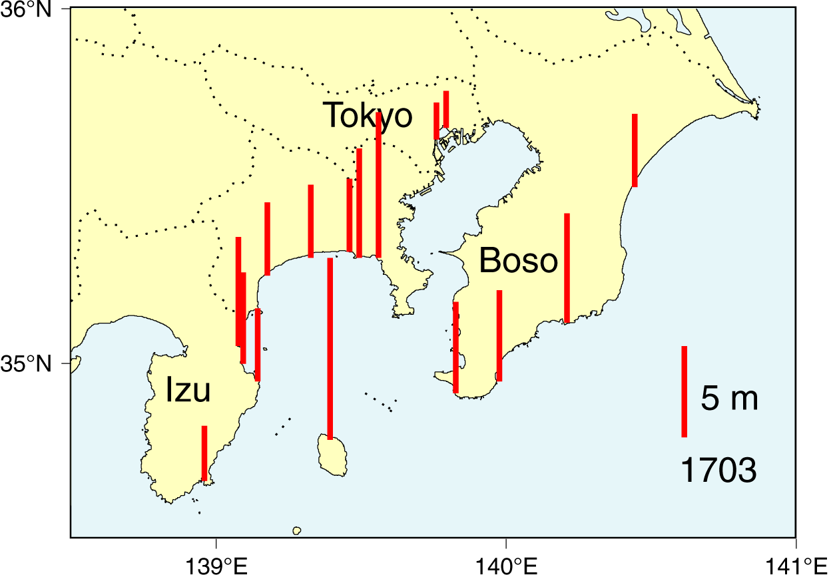
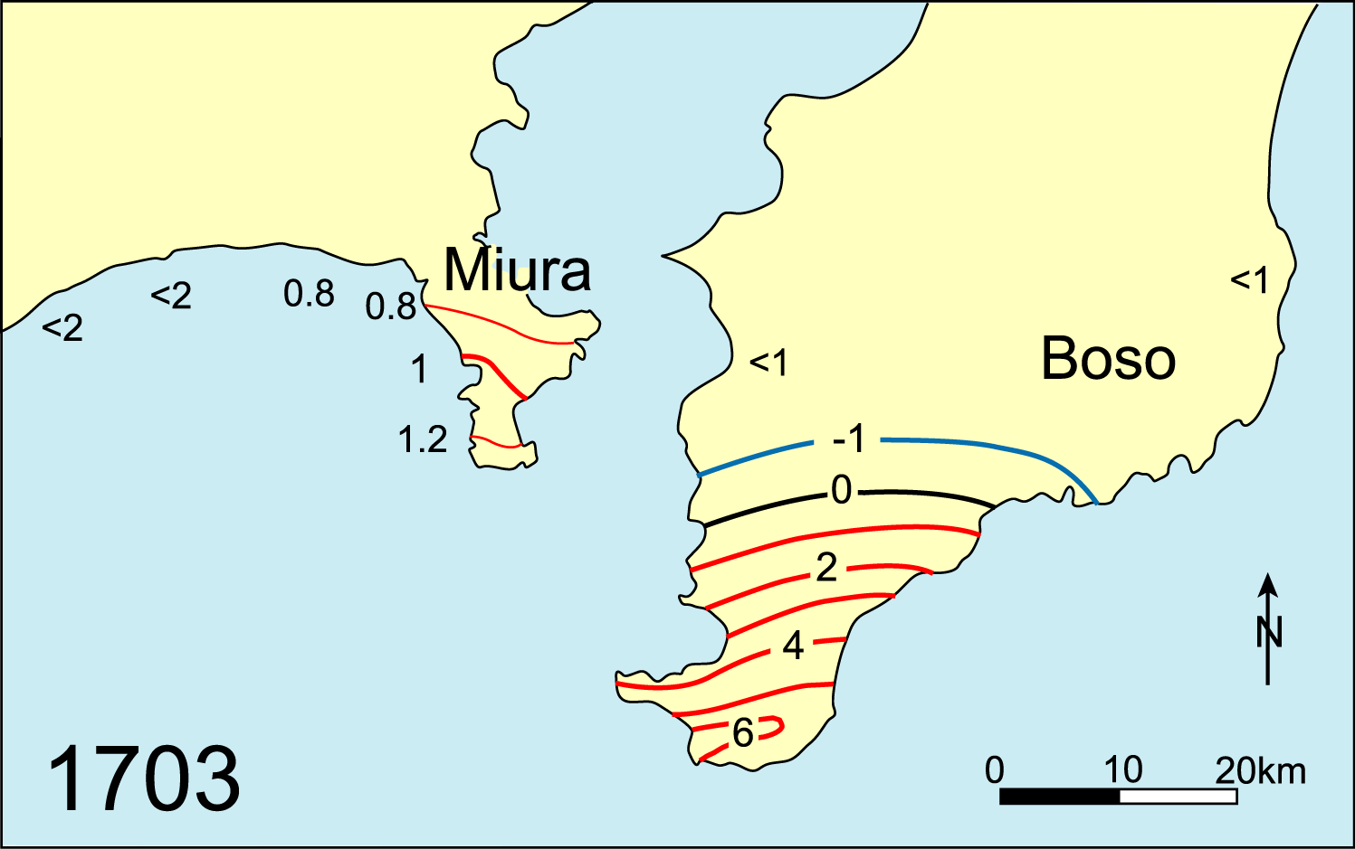
The 1703 (Genroku) Kanto earthquake
Previous earthquake at the plate boundary
Tsunami Heights
Crustal deformation
Shishikura (2003)
Hatori (1975)
Larger tsunami on the Pacific coast of Boso peninsula
Larger uplift on the southern tip of Boso Peninsula

Slide 6
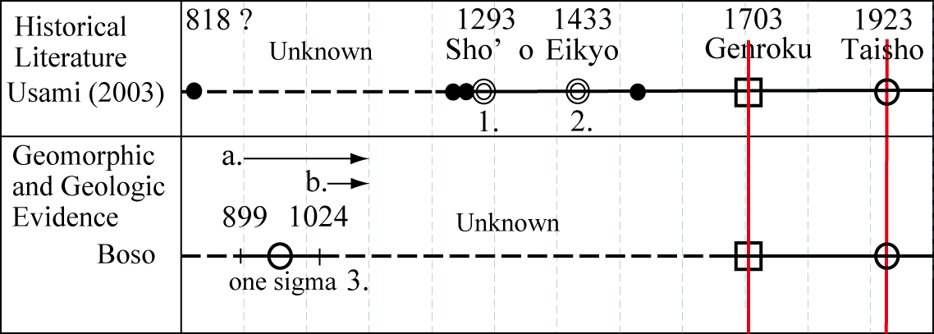
Older earthquake ?
Historical documents since ~ 1200 AD
No geological data since 11th century

Slide 7
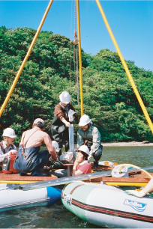
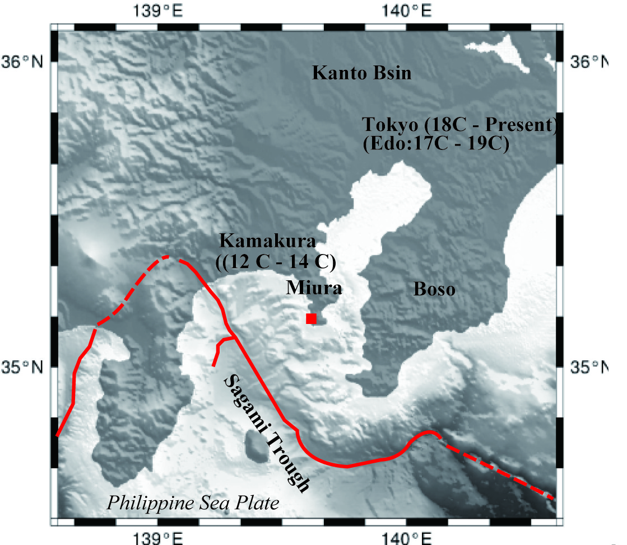
Older earthquake?
Geological surveys in Miura Peninsula (Koajiro Bay)

Slide 8
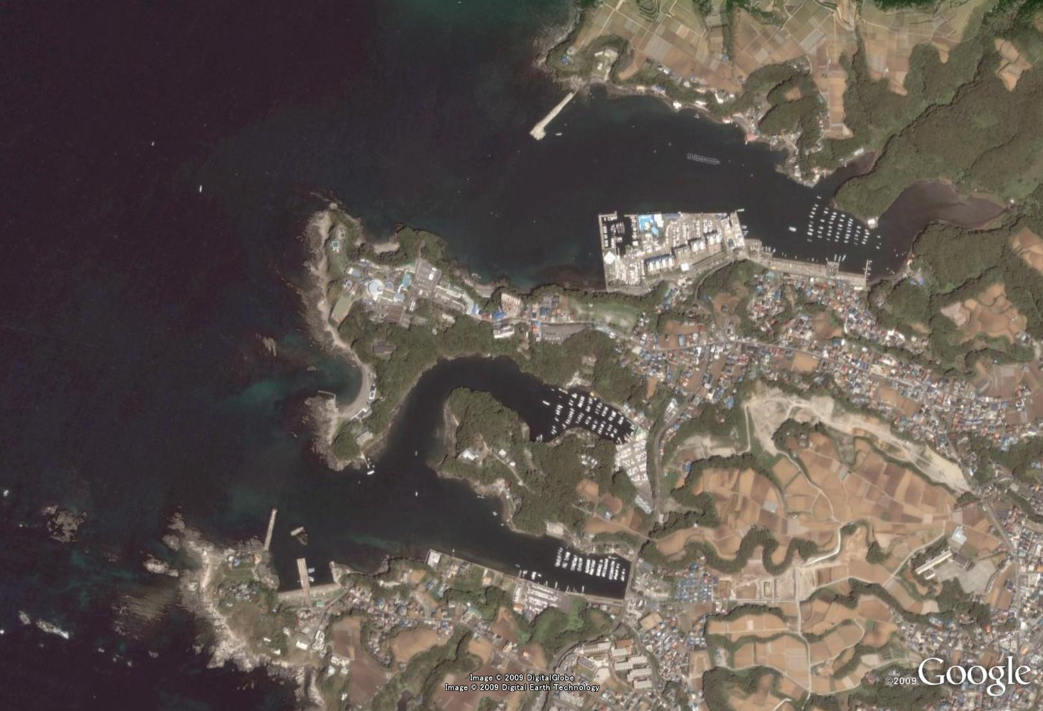
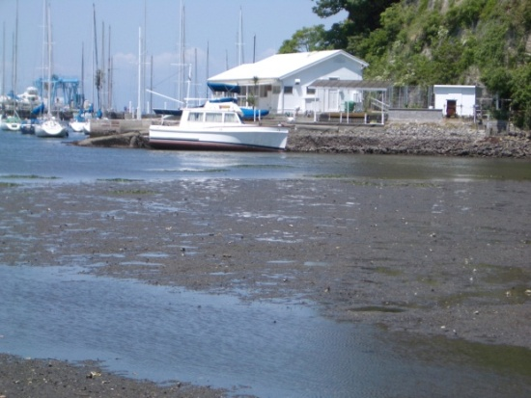
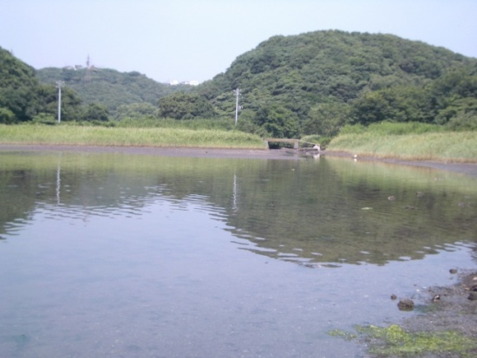
Study Site: Koaijiro Bay
Koajiro Bay
Tidal Flat
Tide Gauge Station
Aburatsubo Bay

Slide 9
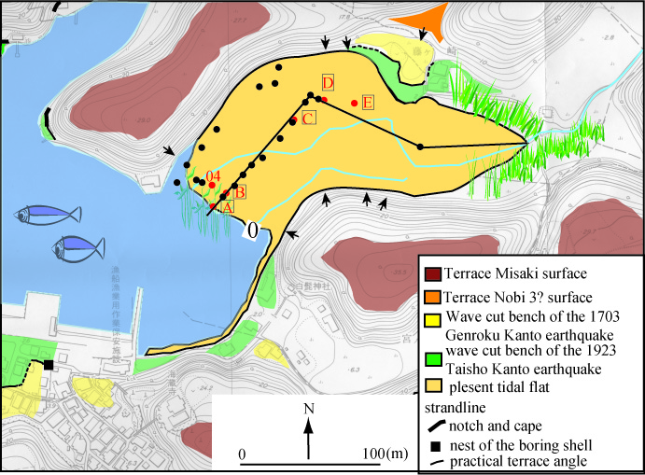
Array Coring using Geoslicer at Tidal Flat

Slide 10
Tsunami Deposits
1923 Kanto Eq.?
T1
1703 Kanto Eq.?
T2
Notes:
10

Slide 11
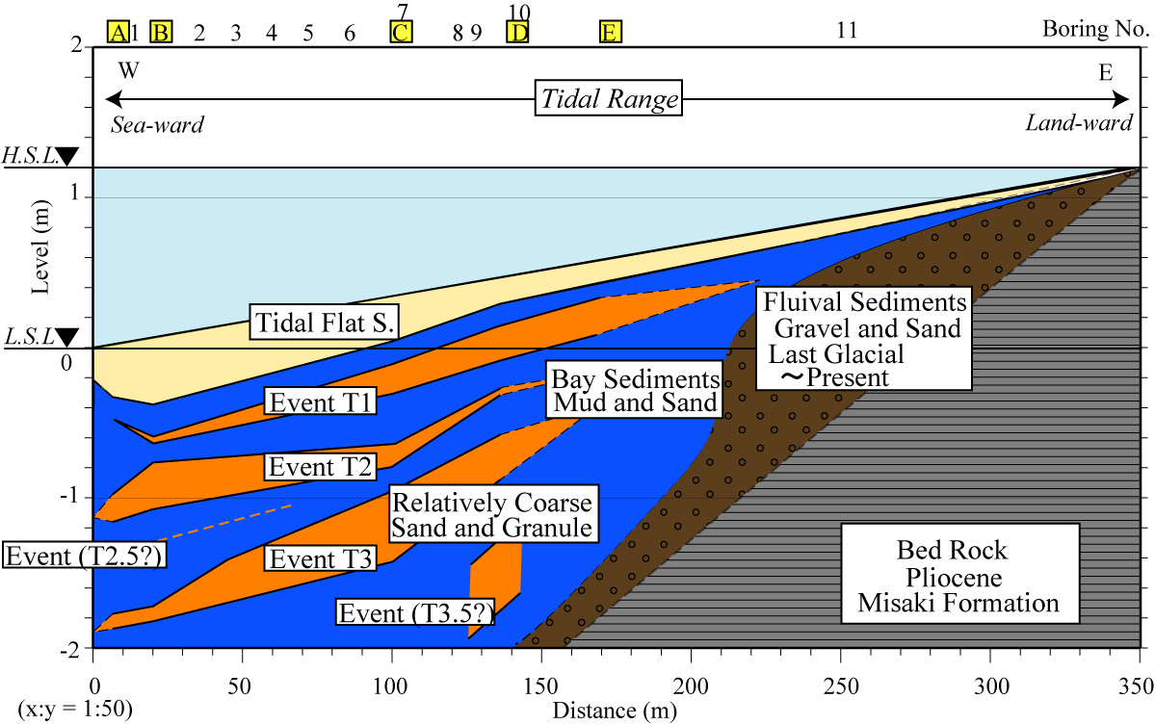
Sequence of Stratigraphy
Seaward
Landward
Three event deposits in the bay sediment beneath tidal flat sediment

Slide 12
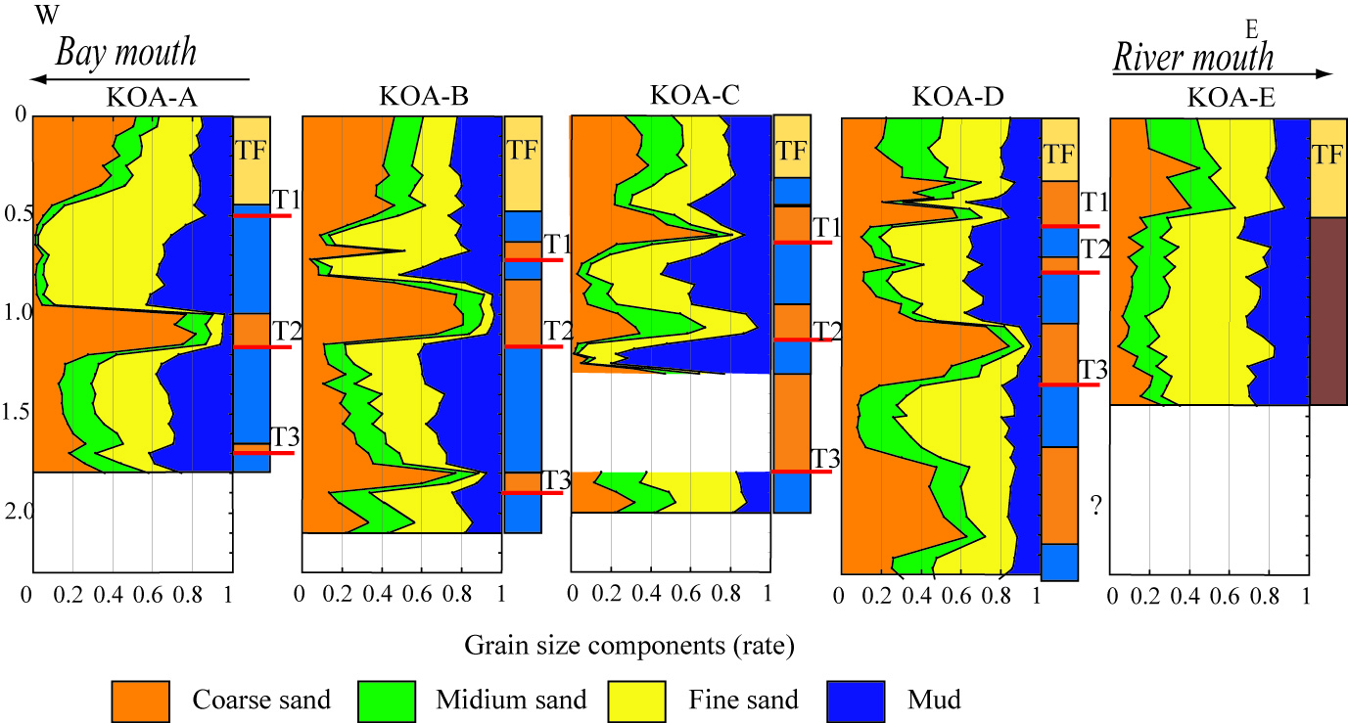
Grain Size Analysis
Event Units composed of the coarse materials.

Slide 13
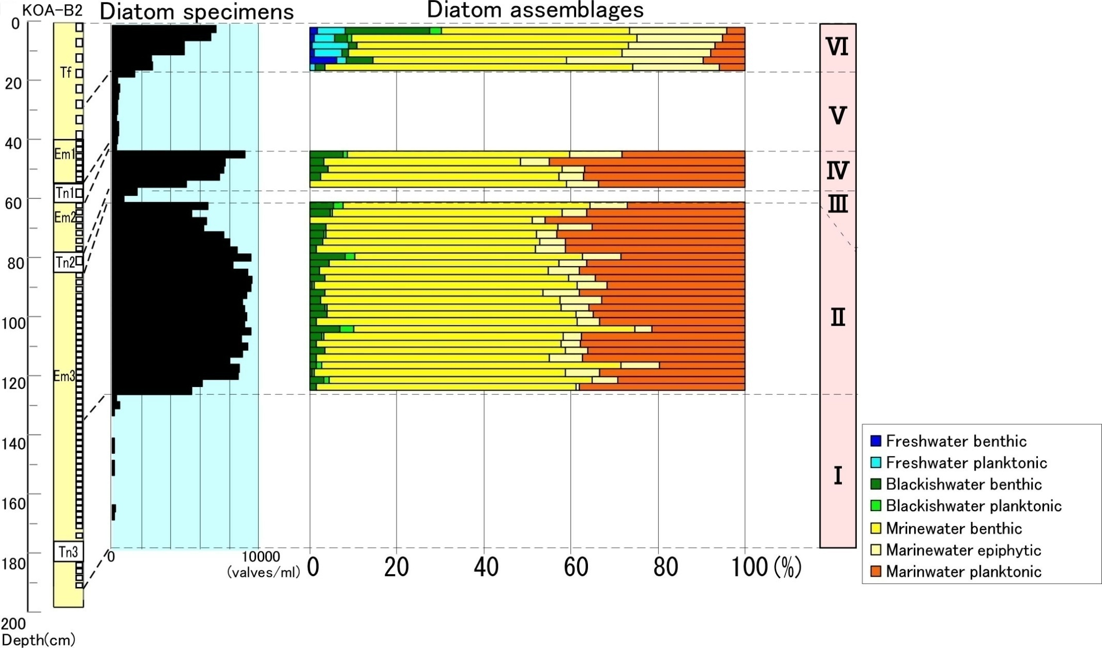
Diatom analysis
Fresh Water Species
Little diatom in event deposits, but increase after events
Graduall increase of
marine plankton
Gradual (interseismic) subsidence and Sudden (coseismic) uplift
Notes:
13

Slide 14
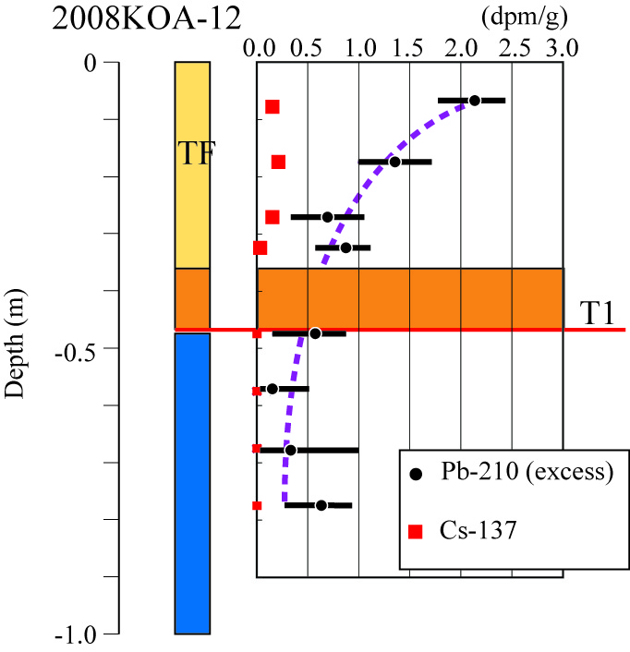
Dating of recent event (Cs, Pb)
Cs-137
Cs-137 and Pb-210 indicate that T1 sand layer is brought by the 1923 Kanto earthquake

Slide 15
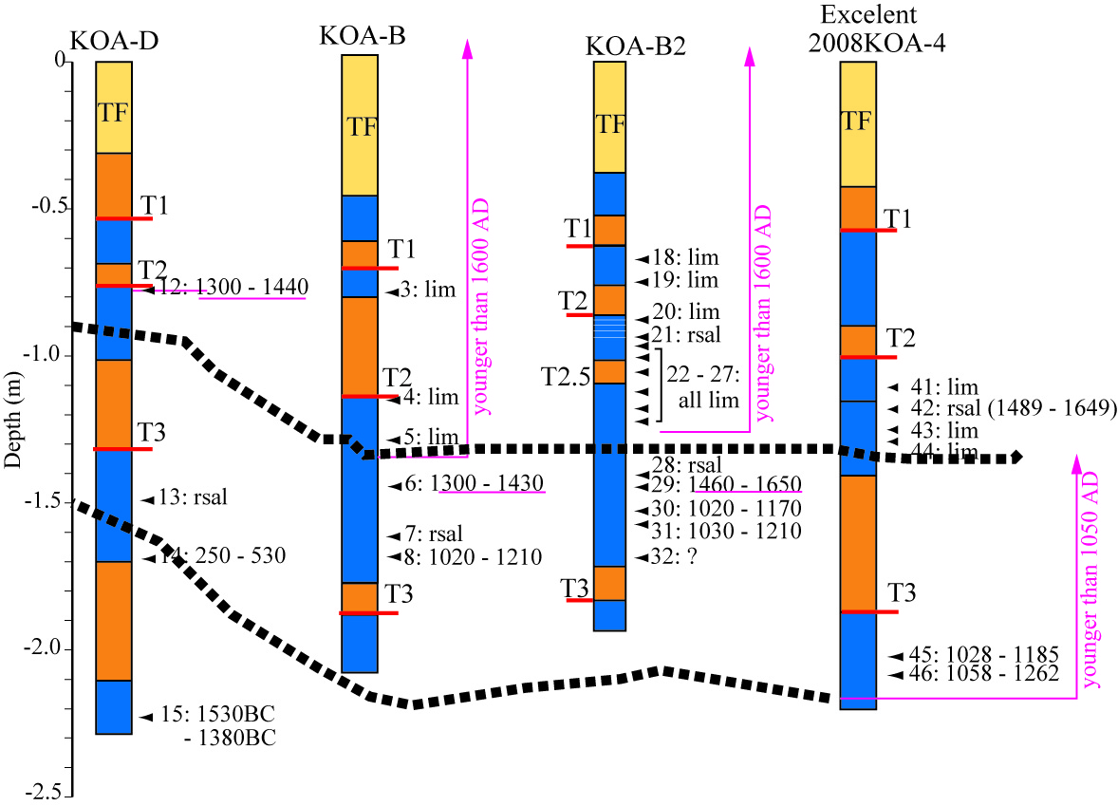
Radiocarbon Dating
T1：1600AD～
T2：1600AD～
T3：1060AD～
1430AD
1060-1260 AD

Slide 16
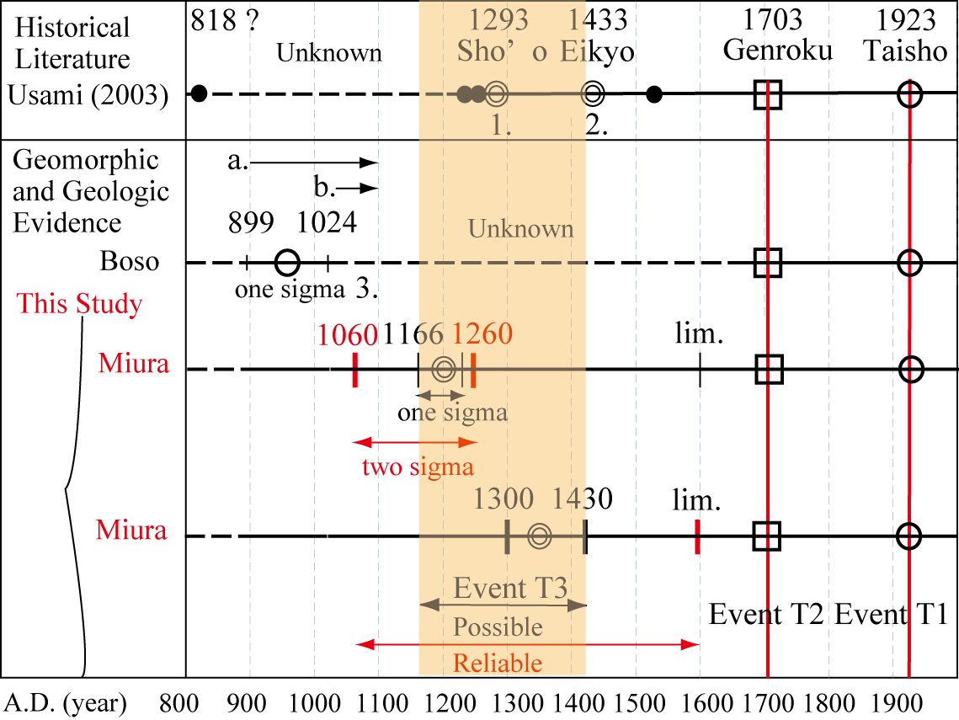
Older earthquake ?
T3 may correlate with 1293 Sho’o earthquake

Slide 17
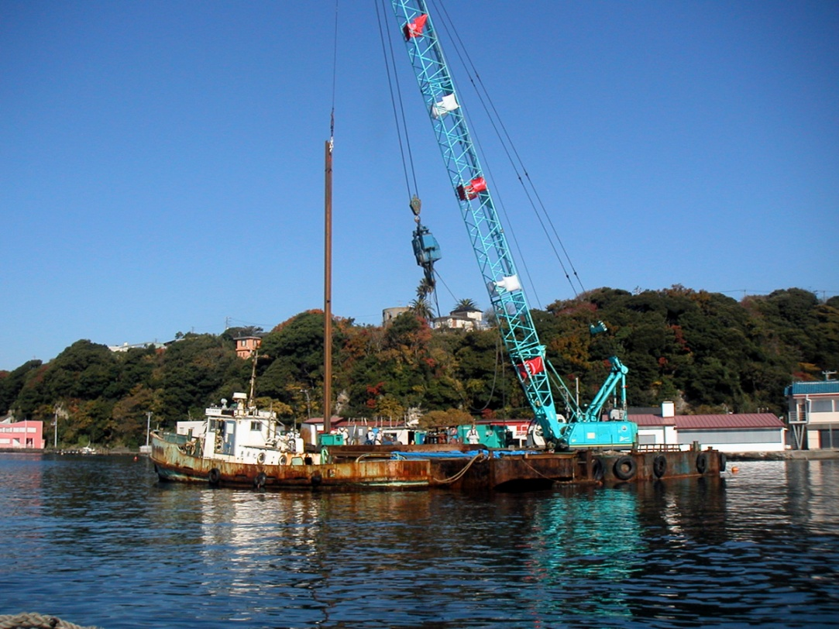
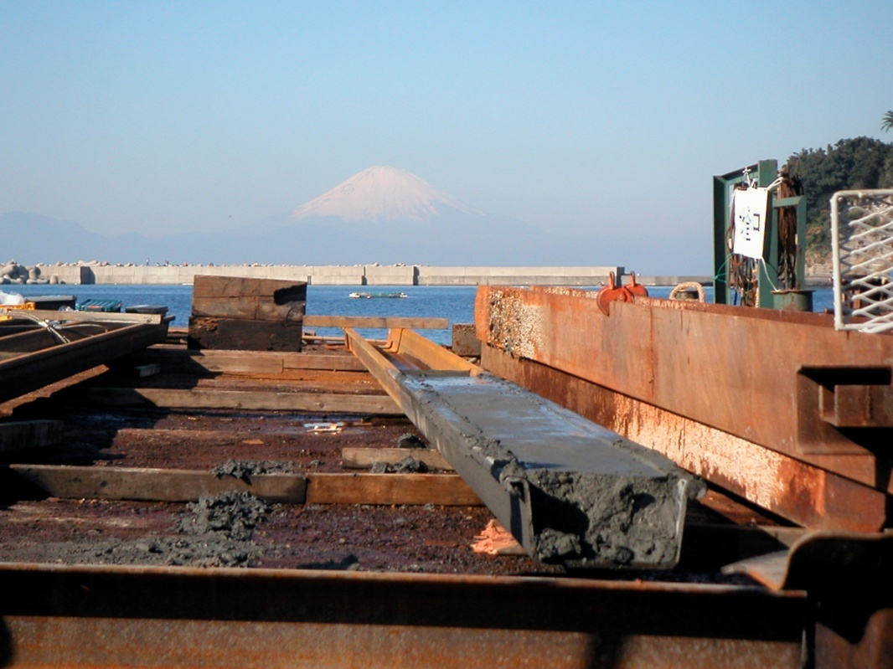
Geoslicer Survey

Slide 18
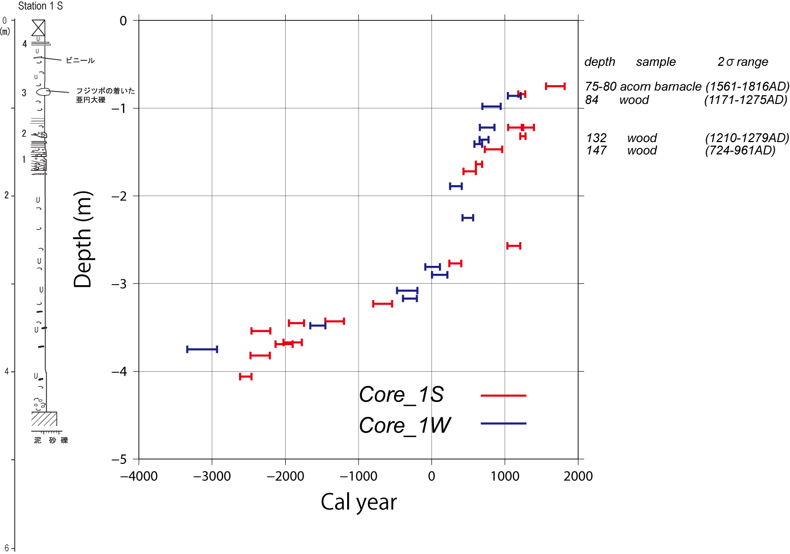

Slide 19
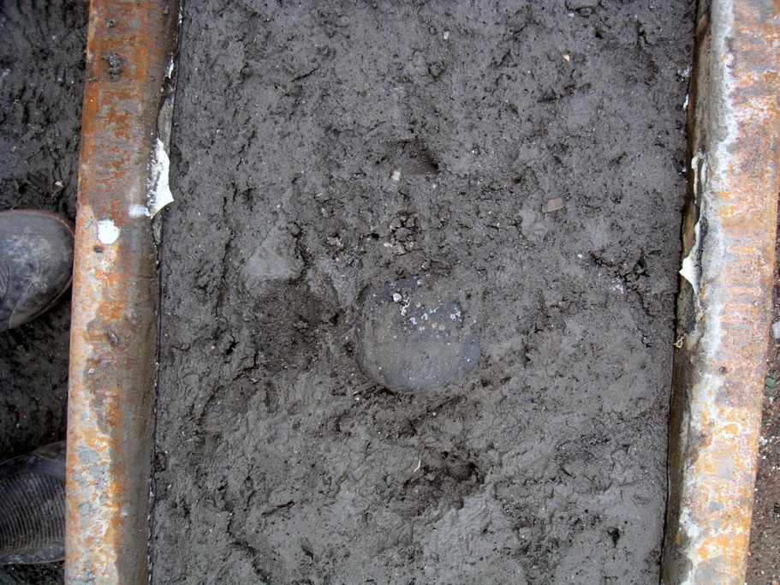
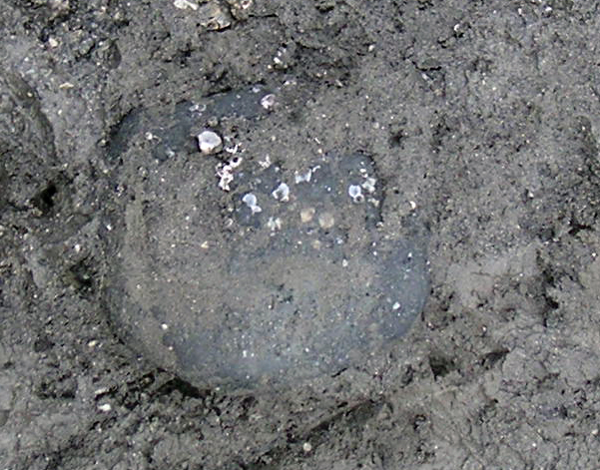
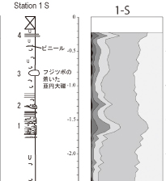
Geoslicer Survey
Balanus 710+-30yBP (1560-1820 AD)
~ 1703 (Genroku) Kanto Eq.
Shell in sand layer
1230-1400AD（Marine Reservoir correction applied）
~ 1293 Kanto Eq.

Slide 20
Conclusions
In Koajiro Bay, three event deposits were identified.
Event T1: The 1923 Taisho Kanto earthquake
Event T2: The 1703 Genroku Kanto earthquake
Event T3: The 1293 Sho’o earthquake
If this is the case, the recurrence intervals are 220 years and 410 years, indicating a variability of recurrence intervals.

